Slide 1
Capstone Management

Slide 2
Problem listing

Slide 3
Project Goal

Slide 4
Project requirement

Slide 5
Project feasibility - Sean

Slide 6
Project Plan - Sean
Sprint/Release plan

Slide 7
Project management - Sean
Github
Trello
Group work autonomously

Slide 8
Project Design - Seyoung

Slide 9
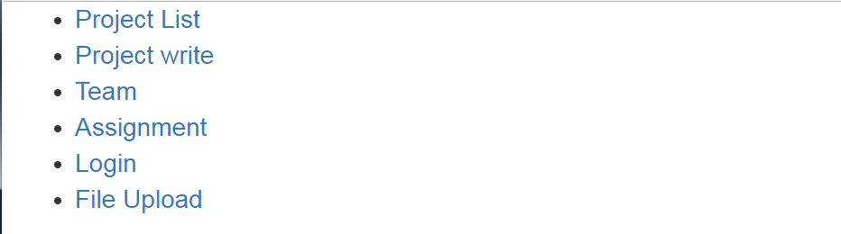
Initial Work and Prototype for web application (Functional prototype pages)
First Page

Slide 10
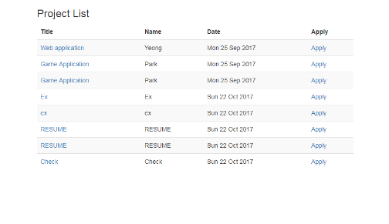
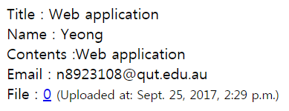
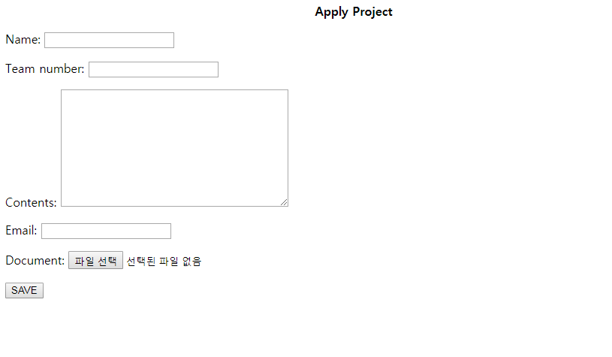
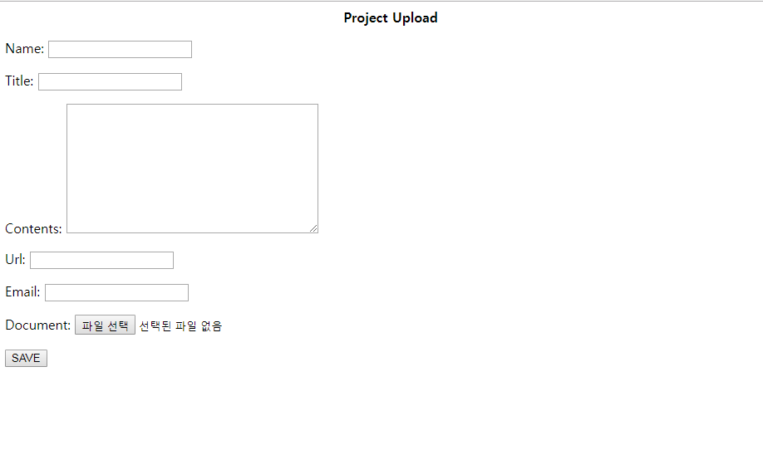
Project Detail
Project List
Project Pages
Project Upload
Apply Project

Slide 11
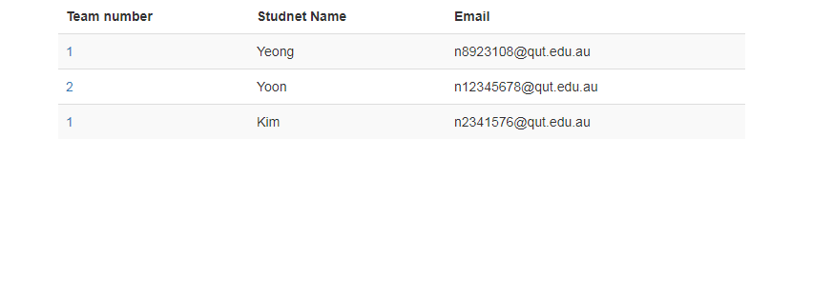
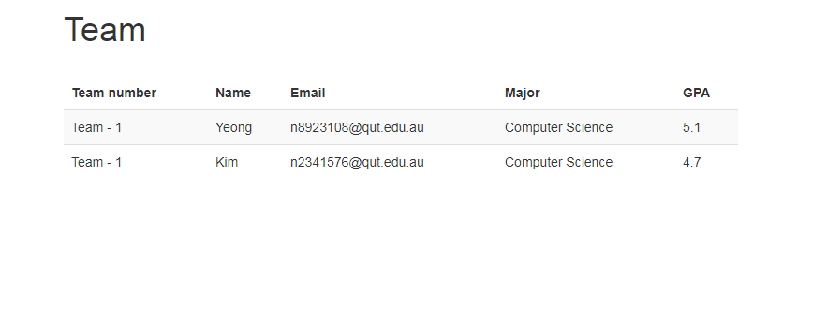
Student Information
Team Member Information
Student & Team Detail

Slide 12

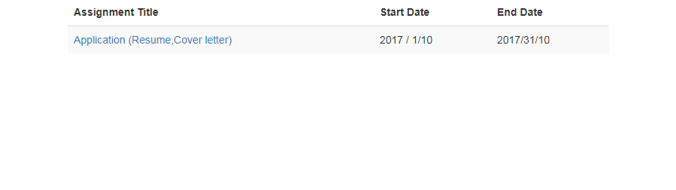
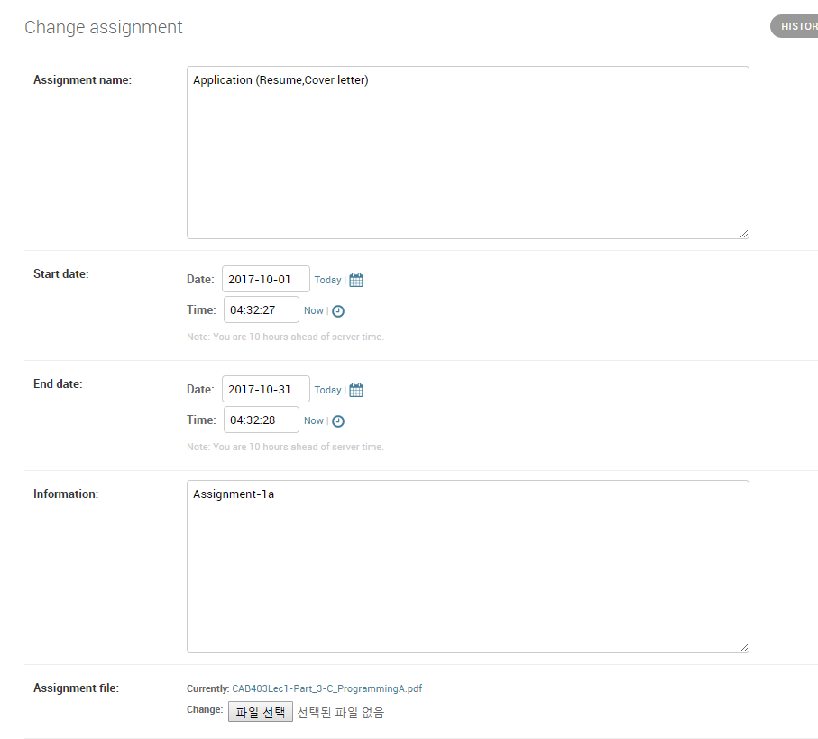
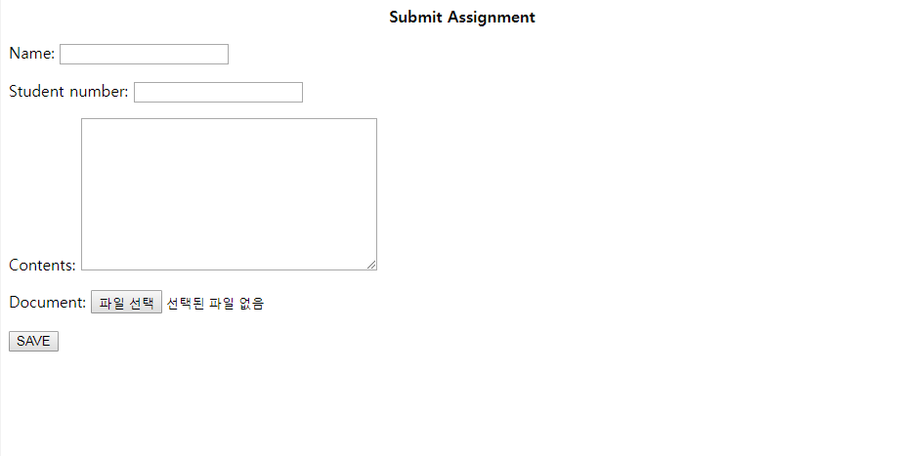
Assignment pages
Assignment Detail
Assignment Detail
Upload Assignment
Submit Assignment

Slide 13
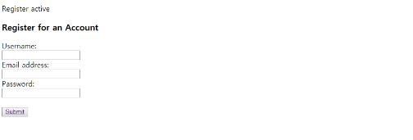
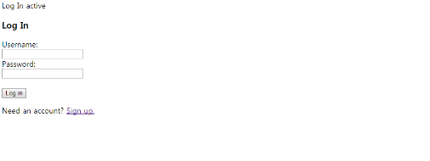
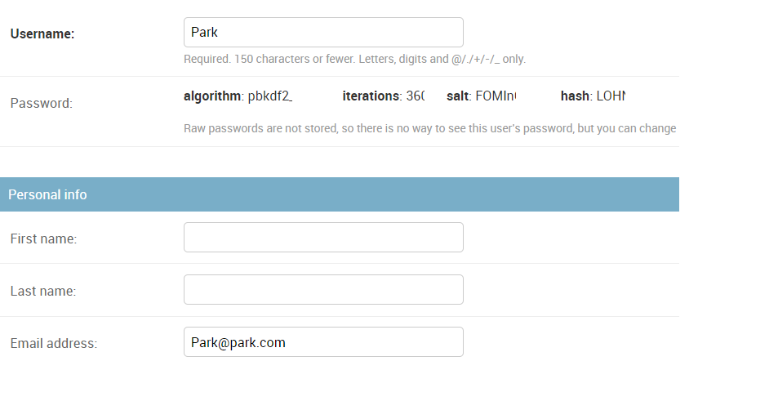
Log-in & Sign-up pages
Sign-Up
User Detail
Log-in

